Slide 1
Topic: Hate Speech / Toxic Comment Detection
REVIEW REPORT - 1
Programme: DATABASE MANAGEMENT SYSTEM
Course: COMPUTER SCIENCE AND ENGINEERING
Slot: D2
Faculty: PREMALATHA M
Component: J
TEAM MEMBERS:
NAME REG. NO.
MUSKAAN YADAV 20BCE1622
JEEL MEHTA 20BCE1117
SRUJANKUMAR.R.A 20BCE1784

Slide 2
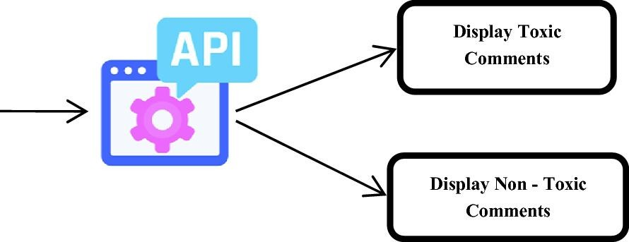
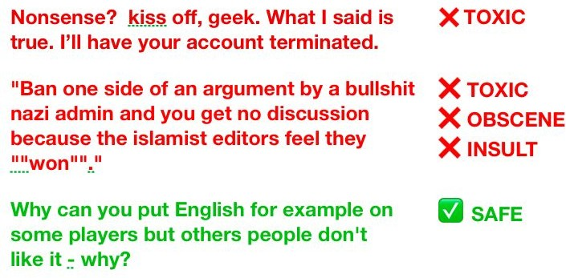
Overview
Detection and Flagging of comments containing text which may incite violence, spread hate and induce negativity.

Slide 3
Introduction
The project Hate Speech / Toxic Comment Detection aims at:
Removing any textual material containing hate or toxicity.
The threat of abuse and harassment online means that many people stop expressing themselves.
Toxic comments spread negativity, racial harassment and depression.

Slide 4
Motivation & Applications- ● Social networking: Message or tweet can be reported to the support team. ● Online meetings / webinars: Message can be hidden from attendees and shown only to the moderators. ● Chatbot training: The model can give large negative feedback for any insulting reply towards the user. ● Threatening messages: Directly reported to concerned authorities for immediate actions.
ABSTRACT:
With the push towards the decline in data rates and growth of telecommunication networks in the last few years, there has been a huge spike in the number of internet users. Penetration of high bandwidth connection into the remotest part of the world has enabled quite a few users to come up online and express their opinions and thoughts. However, the another side of coin is that it has lead to increase in instances of hate speech and bullying which not only holds back certain users from opening up freely with ingenious ideas but also spreads negativity, depression, communal/racial hatred and at times can trigger riots. So it becomes imperative for social media ventures to ensure that their platform is free from toxicity to encourage free flow of information and opinions.

Slide 5





Conclusion and Scope of Improvement
Description of the Problem Statement and Challenges
Preprocessing of data into machine readable format
Problem
Visualisation
Preprocessing
Training
Conclusion
Cleaning and Visualisation of the dataset
Training the model using various methods

Slide 6
Problem Description
Statement
Given any text or paragraph containing a few lines in natural language, the objective is to classify it as belonging to one or more of the following categories: clean, obscene, threatening, insulting, toxic, severely toxic and identity hate.
Clean
OUTPUT
Obscene
Threatening
Text / Paragraph (natural language)
INPUT
ONE OR MORE OF THESE CLASSES
Model
Insulting
Toxic
Severely Toxic
Identity Hate

Slide 7
METHODOLOGY:
Multi-class classification problem
Multi-label classification problem
Seven different classes: Clean, obscene, threatening,
insulting, toxic, severely toxic, identity hate.
Any text or paragraph can be abusive in multiple ways: it can be both threatening & insulting to someone
Model will output the probability of text to belong to each category.
Based on certain threshold (which can be tuned as hyperparameter), the text can be classiﬁed to be belonging to a category / set of categories.

Slide 8
Solution Approach
Dataset
Conversational AI
Data Cleaning & Visualization
Get qualitative high-level insights into the data
Data Pre-processing
Remove punctuations, stop words, stemming, etc.
Binary Relevance
Classifier Chains
Support Vector Machines
Training the model
XGBoost
Extremely Random Trees
Data Post-processing
Reason out the possible source of errors
Recurrent Neural Networks
Transfer Learning

Slide 9
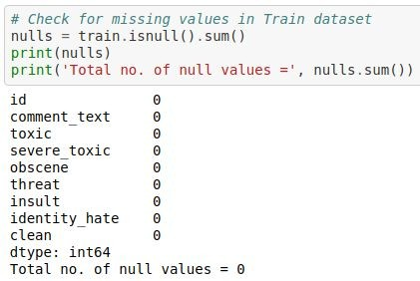
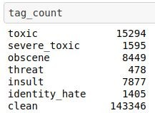

Data Cleaning & Visualization
Checking for missing or null values.
Adding extra column for ‘clean’ comments.

Slide 10
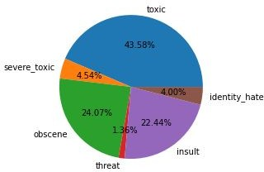
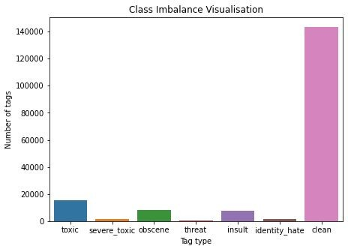
Data Cleaning & Visualization
Class Imbalance: The toxicity is not spread evenly across all the classes. Out of all the hate tags, ‘toxic’ tags are 43.58%, whereas ‘threat’ tags are 1.36%.
Clean comments are ~140k out of the ~160k total comments.

Slide 11
Data Cleaning & Visualization
Comments obtained are from random users on internet
Dataset is noisy. No ﬁxed standard of writing across all the comments
Dataset must be cleaned before further steps to obtain meaningful results
Remove non alphanumeric characters (ip addresses, time, date) and punctuations.
Convert everything to lower case letters.
Detect and remove extremely long words (may cause overﬁtting), non english and meaningless words.

Slide 12
Data Cleaning & Visualization
[18:00 3/7/2010]: Hey man!!, I'm
really not trying to edit war. It's just that this guy is constantly removing relevant information and talking to me through edits instead of my talk page. He seems to care more about the formatting than the actual info. (@172.16.254.1)
hey man i m really not trying to edit war it s just that this guy is constantly removing relevant information and talking to me through edits instead of my talk page he seems to care more about the formatting than the actual info
DATA CLEANING
COMMENT
CLEANED COMMENT

Slide 13

Data Preprocessing
Cleaned Data
out, what, most, any, off, too, have, more, or, the, ours, both, whom, and, of, aren, her, does, from, if, not, own, this, it, a, it's, hers, why, who, now, been, me, ...
STOP WORDS
Data Preprocessing
argue
argued
argu
STEMMING
Machine Readable Format
argues
arguing

Slide 14
Data Preprocessing
Conversion of cleaned data to machine readable format.
Stop Words
Commonly used words which don’t add any meaning to the text.
E.g.: ‘is’, ‘are’, ‘this’, ‘at’, etc.
Removed the stop words using NLTK stopwords corpus.
Stemming
Transforming a word into its base stem, i.e., a set of characters to construct a word and its derivatives.
Helps in reducing the vocabulary of words, which convey the same meaning.
E.g. ‘argue’, ‘argued’, ‘argues’ and ‘arguing’ are reduced to the base stem ‘argu’.

Slide 15
Data Preprocessing
hey man i m really not trying to edit war it s just that this guy is constantly removing relevant information and talking to me through edits instead of my talk page he seems to care more about the formatting than the actual info
hey man realli tri edit war guy constantli remov relev inform talk edit instead talk page seem care format actual info
DATA PREPROCESSING
CLEANED COMMENT
COMMENT IN MACHINE READABLE FORM

Slide 16
Training Models or Algorithms

Slide 17
Decision Trees
A non-parametric supervised learning method used for classiﬁcation and regression.
The goal is to create a model that predicts the value of a target variable by learning simple decision rules inferred from the data features.
In decision analysis, a decision tree can be used to visually and explicitly represent decisions and decision making
Growing a tree involves deciding on which features to choose and what conditions to use for splitting, along with knowing when to stop

Slide 18
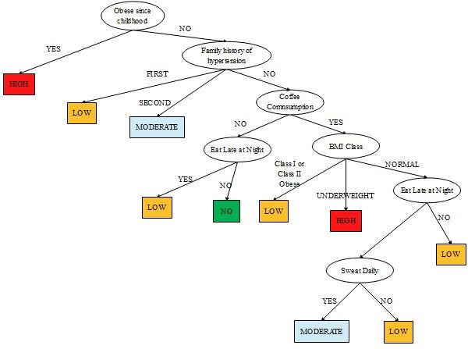
Decision Trees

Slide 19
Decision Trees
Tree models where the target variable can take a discrete set of values are called classiﬁcation trees
In these tree structures, leaves represent class labels and branches represent conjunctions of features that lead to those class labels
Advantages:
Able to handle multi-output problems.
The cost of using the tree is logarithmic in the number of training data points.
Uses a white box model
Requires little data preparation

Slide 20
Decision Trees
Shortcomings:
Decision-tree learners can create over-complex trees: overﬁtting
The problem of learning an optimal decision tree is known to be NP-complete.
There are concepts that are hard to learn because decision trees do not express them easily, such as XOR, parity or multiplexer problems.
Decision tree learners create biased trees if some classes dominate.
Decision trees can be unstable because small variations in the data might result in a completely different tree being generated.
Some of these problems can be mitigated by using decision trees with an ensemble.

Slide 21
Random Forest
Fitting decision trees on bootstrapped data serves to decorrelate them slightly.
Since each node chooses what feature to split on in a greedy manner, trees can still end up very correlated with each other.
Random forests decorrelates the individual decision trees.
When the CART algorithm is choosing the optimal split to make at each node, the random forest will choose a random subset of features and only consider those for the split.
From that random subset of features, the algorithm will still select the optimal feature and optimum split to make at each node.

Slide 22
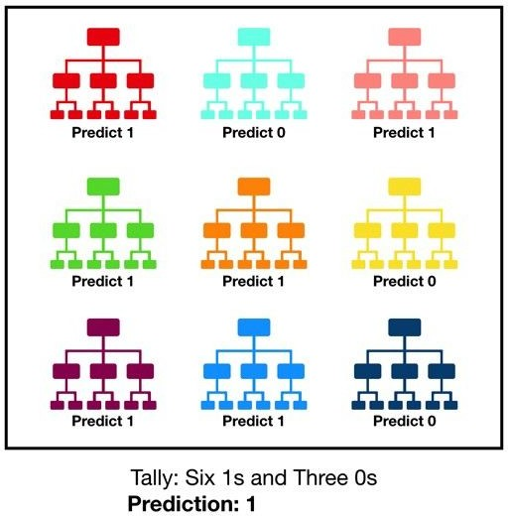
Random Forest

Slide 23
Extremely Randomized Trees
Much more computationally efﬁcient than random forests.
Performance is almost always comparable. In some cases, they may even perform better!
Adds one more step of randomization to the random forest algorithm.
Random Forest chooses the optimum split to make for each feature while Extra Trees chooses it randomly - so it is faster.
Both of them will subsequently choose the best feature to split on by comparing those chosen splits.
From this reason comes the name of Extra Trees (Extremely Randomized
Trees)

Slide 24
Extremely Randomized Trees
Random forest uses bootstrap replicas it subsamples the input data with replacement.
Extra Trees use the whole original sample.
In the Extra Trees sklearn implementation there is an optional parameter that allows users to bootstrap replicas, but by default, it uses the entire input sample.
These differences motivate the reduction of both bias and variance.
Using the whole original sample instead of a bootstrap replica will reduce bias.
Choosing randomly the split point of each node will reduce variance.

Slide 25
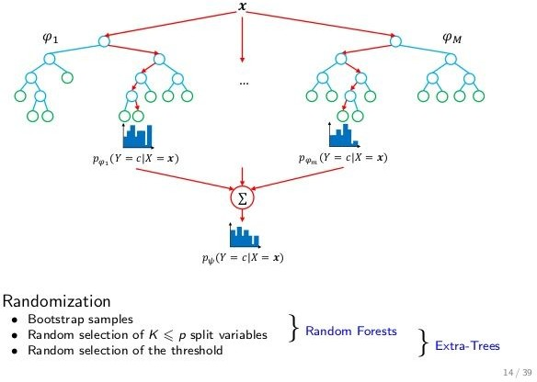
Extremely Randomized Trees

Slide 26
NAIVE BAYES It is a classification technique based on Bayes’ Theorem with an assumption of independence among predictors. In simple terms, a Naive Bayes classifier assumes that the presence of a particular feature in a class is unrelated to the presence of any other feature. For example, a fruit may be considered to be an apple if it is red, round, and about 3 inches in diameter. Even if these features depend on each other or upon the existence of the other features, all of these properties independently contribute to the probability that this fruit is an apple and that is why it is known as ‘Naive’. Naive Bayes model is easy to build and particularly useful for very large data sets. Along with simplicity, Naive Bayes is known to outperform even highly sophisticated classification methods.

Slide 27
THANK YOU

